Slide 1
TDD – STUBS AND DRIVERS
SE – BSCS – FALL 2017

Slide 2
Stubs
Stubs: If the function A you are testing calls another function B, then use a simplified version of function B, called a stub. A stub returns a value that is sufficient for testing. The stub does not need to perform the real calculation.
//Program 12
void function_under_test(int& x, int& y)
{ ... p = price(x); ...}
double price(int x) {return 10.00;}
The value returned by function price is good enough for testing. The real price() function may not yet have been tested, or even written.

Slide 3
Test Driver
Test driver: allows you to call a function and display its return values. should be as simple as possible "throw away" code
// Program 11// Savitch Problem Solving with C++, 4.10//Driver program for the function
get_input.#include <iostream.h>
void get_input(x& cost, int& y);
//Precondition:
User is ready to enters values correctly.
//Postconditions:
The value of cost has been set to the //wholesale cost of one item. The value of turnover has been //set to the expected number of days until the item is sold.

Slide 4
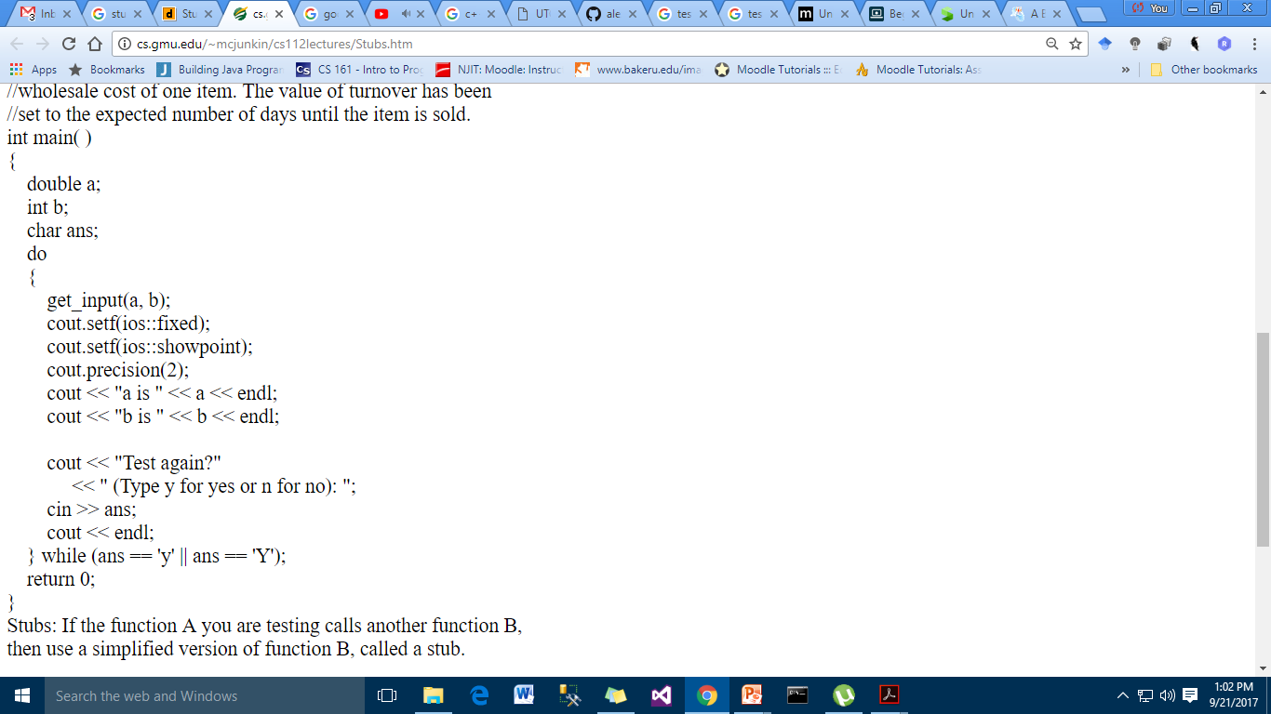
Driver

Slide 5
Stubs and drivers are very helpful tools for testing and debugging programs that use functions. They allow you to test the individual functions in a program, in isolation from the parts of the program that call the functions.
A stub is a dummy function that is called instead of the actual function it represents. It usually displays a test message acknowledging that it was called, and nothing more. For example, if a stub were used for the showFees function.

Slide 6
void showFees(double memberRate, int months)
{
cout << "The showFees function was called with "
<< "the following arguments:\n"
<< "memberRate: " << memberRate << endl
<< "months: " << months << endl;
}

Slide 7
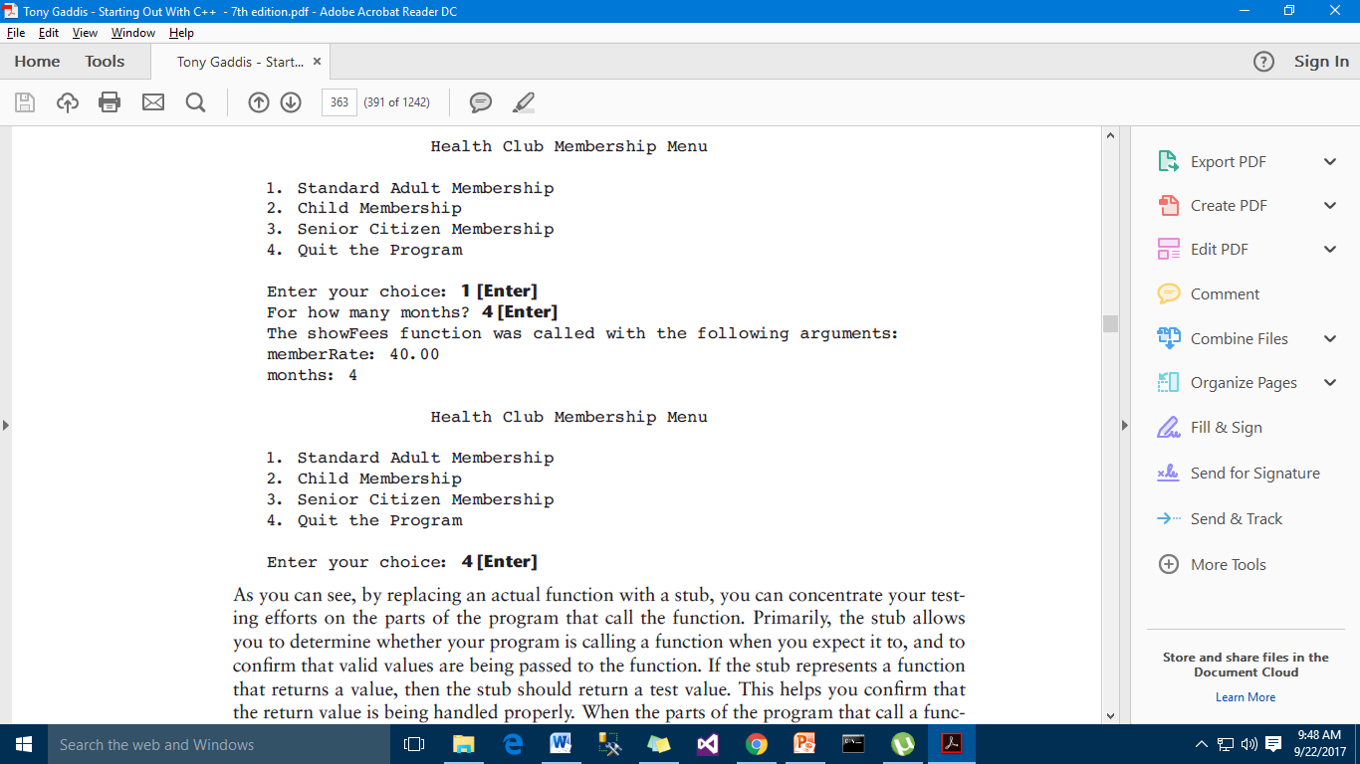
PROGRAM OUTPUT WITH STUB FUNCTION

Slide 8
